Slide 1
Customer Segmentation
Neha Varshney 2023

Slide 2

Introduction
Segmentation is a broad category of analytic techniques that allow us to group similar data points.
In this project, data points will represent customers, who will be group according to their shopping behavior in the context of a very specific business initiative.
The main objective of this project is to retain and add value to existing customers with a marketing strategy built on a solid understanding of customer behavior.

Slide 3
Data Exploration and Metrics Calculation
The data was explored in the TravelTide dataset using SQL
Metrics were calculated for tracking the customer behavior.
We looked for data that signals particular interest in the perk.
Some of the calculated metrics are:
discount of flightproportion
average of flightdiscount
average dollars saved
conversion rate of the customers
average session time

Slide 4
KEY FINDINGS
5998 customers booked the flights under the discount.
5998 customers booked the hotels under the discount.
The conversion rate of customers is 38.2
The amount of dollars saved per kilometer traveled on average is 0.046132085
The amount of flight discount on average for customers is between 0.05 - 0.55 after rounding.
The amount of hotel discount on average for customers is between 0.05 - 0.45 after rounding.
The amount of dollars saved per kilometer on average traveled is 0.046132085
The most frequent average number of page clicks per customer is 0.10952381
The most frequent average session time per customer is 0.31040418

Slide 5
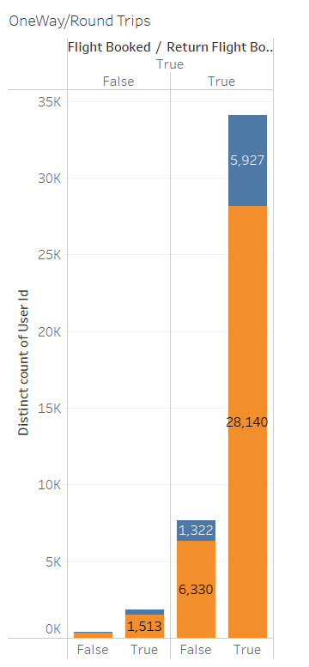
Customer Segmentation Results
33,382 customers who booked 41,303 trips were from USA.
8697 customers who booked 7167 trips were from Canada.
28,140 customers from USA booked round trip
5,927 customers from Canada booked round trip
1513 customers from USA booked one way trip
362 customers from Canada booked one way trip
Other customers booked were either returning home or visiting friends.

Slide 6
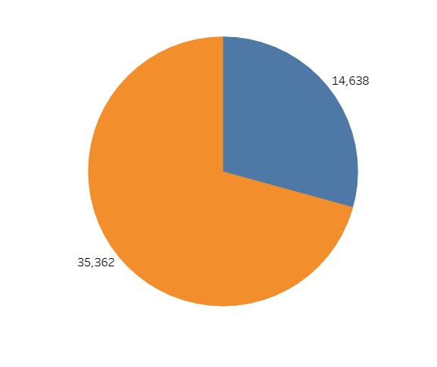
35,362 customers planned trips in non-holiday season
14,438 customers planned trips in holiday season
The base fare in non-holiday period is around 704$ on average.
The base fare in holiday period is around 730$ on average.

Slide 7
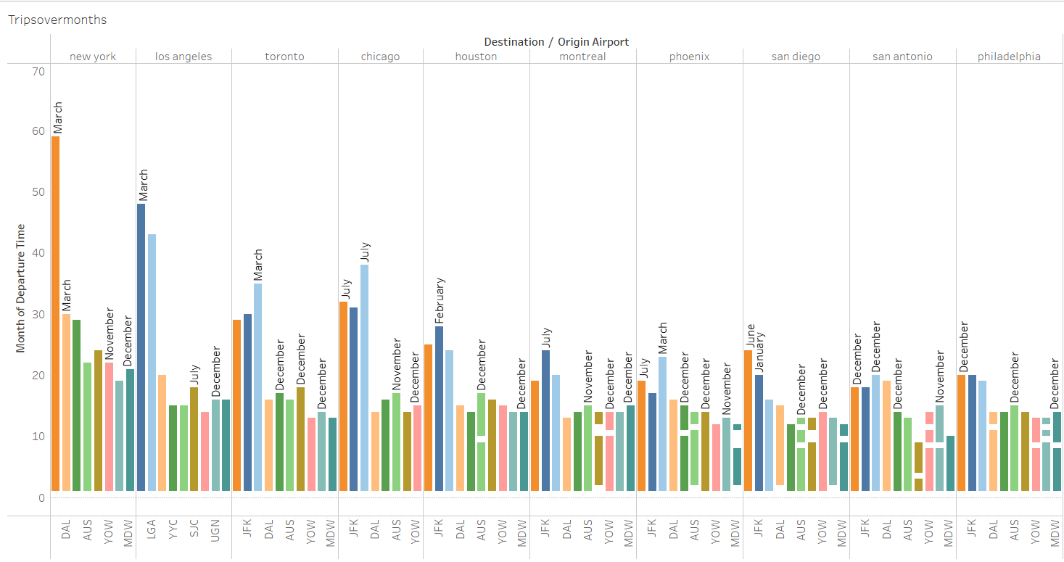
Majority of trips were being taken within the United States
8 out of top ten searched countries are within United States.
The most popular months are March and July.

Slide 8
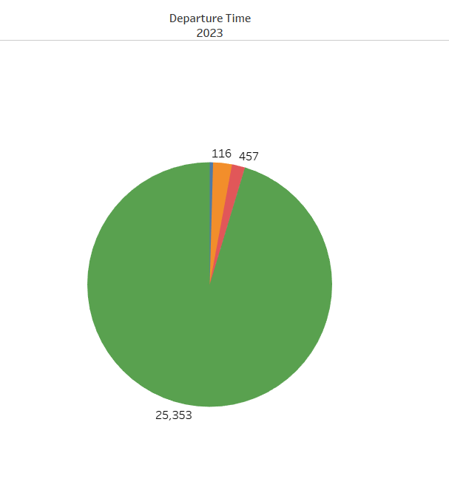
25,353 customers were placed in ‘Very Low’ category.
116 customers were placed in ‘High’ category.
662 customers were placed in ‘Low’ category.
457 customers were placed in ‘Medium’ category.

Slide 9
RECOMMENDATION
The base fare in non-holiday period is around 704$ on average.
The base fare in holiday period is around 730$ on average.
The customers are booking trips in non-holiday period.
The base fare on average is almost same in both the seasons.
The customers are not booking on the basis of fare. If we provide decent base fare in holiday season as well, that would help us in retaining the customers.

Slide 10
THANK YOU

